Slide 1
STAN for Hamiltonian MCMC
General, powerful, surprisingly painless
John Tillinghast
GEICO
Adjunct at American University

Slide 2
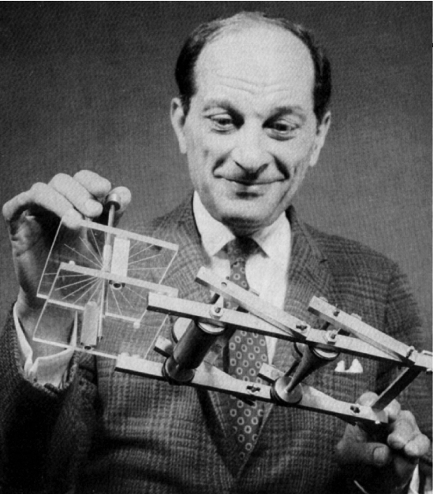
Stan Ulam, inventor of Monte Carlo
Developed Monte Carlo integration/estimation for problems too complicated for analytic methods

Slide 3

…and of course, my dad
(not really, I am not on the Stan team)

Slide 4
The general problem
Suppose we have random variables
Probability density is a function of y and maybe some other parameters (θ)
We want the expectation of some function of y
In Bayesian problems, it’s the expectation of θ

Slide 5
The Monte Carlo idea
We can’t compute the expectation analytically.
But maybe we can generate some sample values of y and take the average .
For example, simulate from a normal distribution for X and take the average of X².

Slide 6
Hamiltonian MCMC
It’s hard to sample directly from a complicated distribution
Markov Chain Monte Carlo (MCMC) is when each sample point is chosen in a way that depends on the last sample point
Hamiltonian MCMC: define physical system where the energy function is determined by the probability density
Samples come from evolution of physical system

Slide 7
Advantages of Stan (especially Rstan)
Very high-level modeling language
Converted to C++
Compiled and optimized – fast runs!
For Rstan, can be dropped straight into R code

Slide 8

Stock market example
Shows power and generality of Stan
Variables are stock value on day 1, on day 2, etc.

Slide 9
When y is a time series
Vector y is a set of stock prices over time
No simple expression for likelihood of given values (in general)
You have to loop over the variables, multiply conditional probabilities
Super-trivial example:

Slide 10
sample_code <- '
data {
#Variables can be constrained with a lower bound – Stan can just do it!
int <lower=0> n;
real <lower=0> y[n];
}
parameters {
real mu;
real <lower=0> sigma;
}
model {
#Likelihood defined by a loop
for (i in 1:n) {
log(y[i]) ~ normal(mu, sigma);
#Correct for transformation
lp__ <- lp__ - log(fabs(y[i]));
}
}

Slide 11
To summarize…
Very general (can handle non-explicit distribution)
High-level modeling language allows quick setup
Clever optimizations and compiling
Good documentation
http://mc-stan.org/

Slide 12
A little brag…

